Slide 1
Firms, Revenues, and Profits
Rajiv Sethi and the CORE Team
October 25, 2021

Slide 2
Overview
The structure of a firm
Owners, managers, and workers
Publicly traded firms
Price, quantity, revenue, and costs
Demand curves and isoprofit curves
Optimal production and pricing
Reading: The Economy Units 6.1-6.3 and 7.1

Slide 3
Structure of a Firm

Slide 4
The Structure of a Firm
Most production of goods/ services in the US occurs within private firms
Organizations that purchase inputs, hire workers, sell output
Include sole proprietorships, partnerships, and corporations
Firms have owners, managers, and (non-managerial) employees
In a sole proprietorship a single person may play all roles
In a corporation there may be millions of dispersed owners
Ownership may change hands frequently through trading of shares
People may not even know what they own in retirement accounts
Stable representation of owners is by board of directors

Slide 5
Publicly Traded Companies
Many large companies issue shares that are traded on stock exchanges
The holders of these shares are the owners
Profits are distributed to owners in the form of dividends
But these owners have neither expertise nor interest in managing firm
They hold shares largely as a vehicle for retirement savings
Often delegate trading activity to fund managers (Fidelity, Vanguard)
University endowments are major owners, may not know what they own
Example: The logic behind Barnard’s unique divestment proposal

Slide 6
The Size of Corporations
One measure of size: number of employees
Largest employer among US firms is Walmart (over 2 million)
Another measure is market capitalization
This is the total value of all shares held by the public
The total number of shares outstanding multiplied by share price
Fluctuates as share price changes, can change sharply over course of day
Largest capitalization: Microsoft, Apple, Amazon, Alphabet
All close to a trillion dollars market capitalization

Slide 7
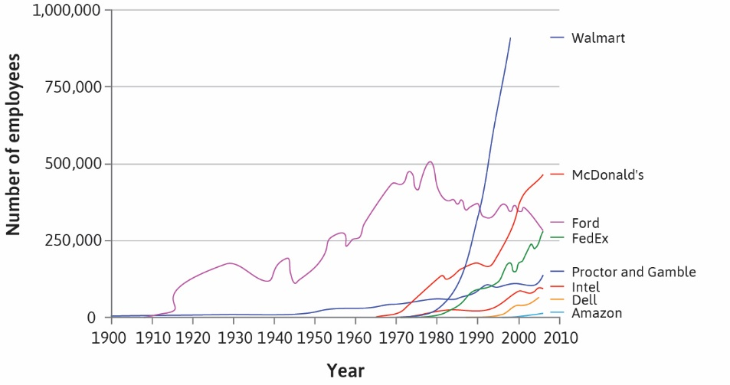

Slide 8
Firm Decisions
Firm managers (supervised by directors) make many decisions
What to produce and how?
How much to invest in marketing or new product development?
How many employees to hire, in which jobs, and at what wages?
Where to source inputs?
How to price outputs?
How much profit to retain or distribute as dividends?

Slide 9
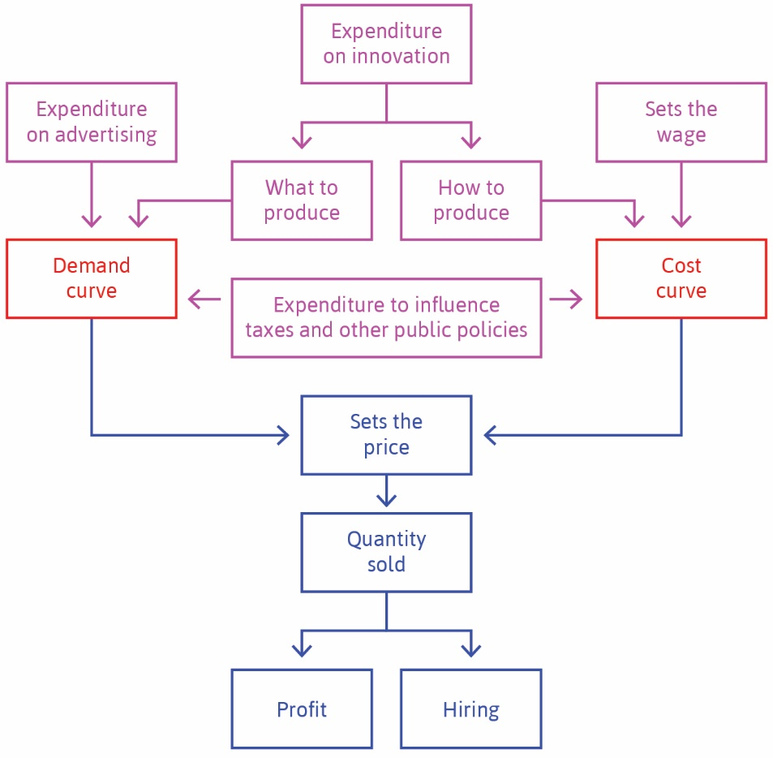

Slide 10
The Demand Curve
Firms cannot choose both price and quantity
They can choose how much to produce and then sell at market price
Examples: oil producers, farmers
Or they can set a price and sell whatever amounts consumers want
Examples: restaurants, publishers, automobile manufacturers
In general, the higher the price set, the lower the sales
High prices lead to substitution by consumers (shift to other products)
And also have income effects as consumers can’t buy as much
This results in a downward-sloping demand curve

Slide 11
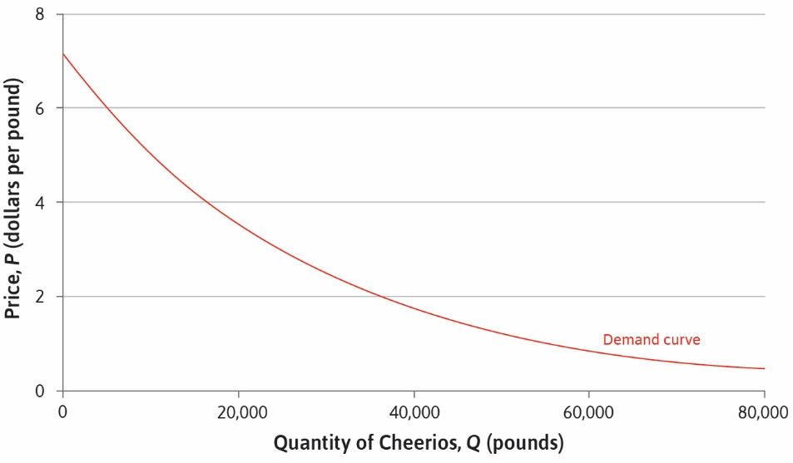

Slide 12
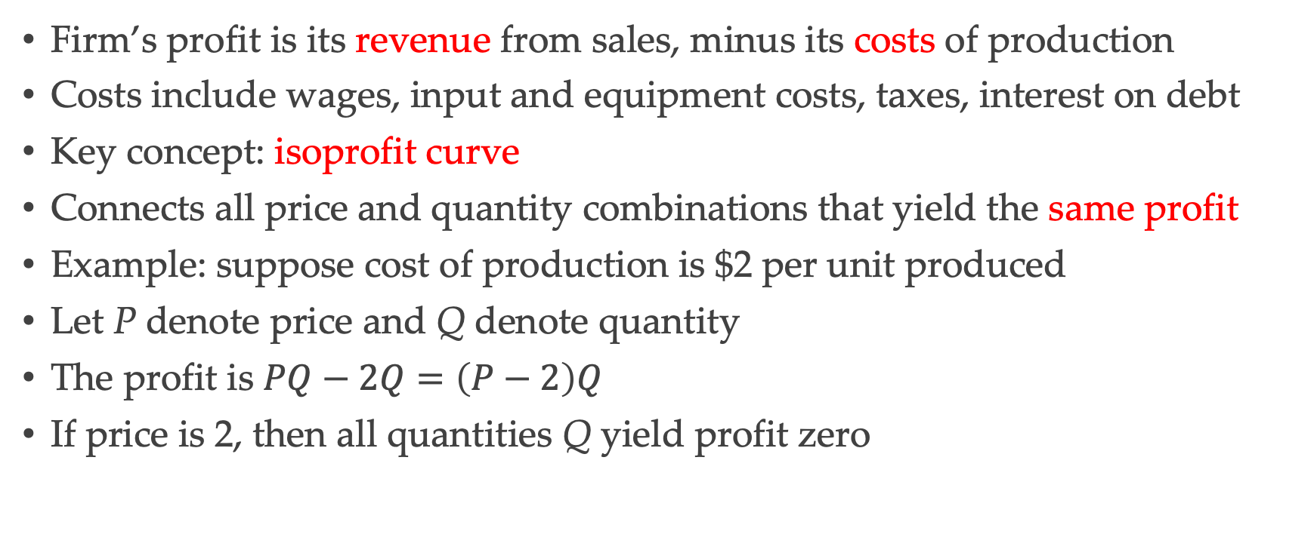
Profits
Firm’s profit is its revenue from sales, minus its costs of production
Costs include wages, input and equipment costs, taxes, interest on debt
Key concept: isoprofit curve
Connects all price and quantity combinations that yield the same profit
Example: suppose cost of production is $2 per unit produced
Let P denote price and Q denote quantity
The profit is $PQ−2Q=\left(P−2\right)Q$
If price is 2, then all quantities Q yield profit zero

Slide 13
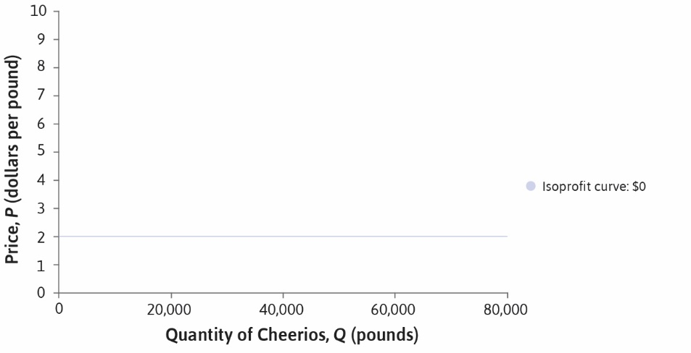

Slide 14
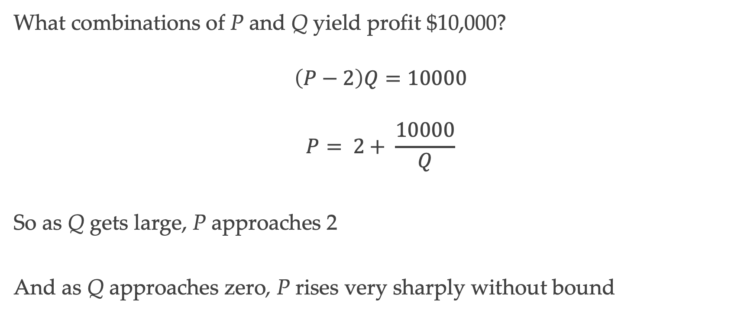
Isoprofit Curve
What combinations of P and Q yield profit $10,000?
$$\left(P−2\right)Q=10000$$
$$P= 2+ \frac{10000}{Q}$$
So as Q gets large, P approaches 2
And as Q approaches zero, P rises very sharply without bound

Slide 15
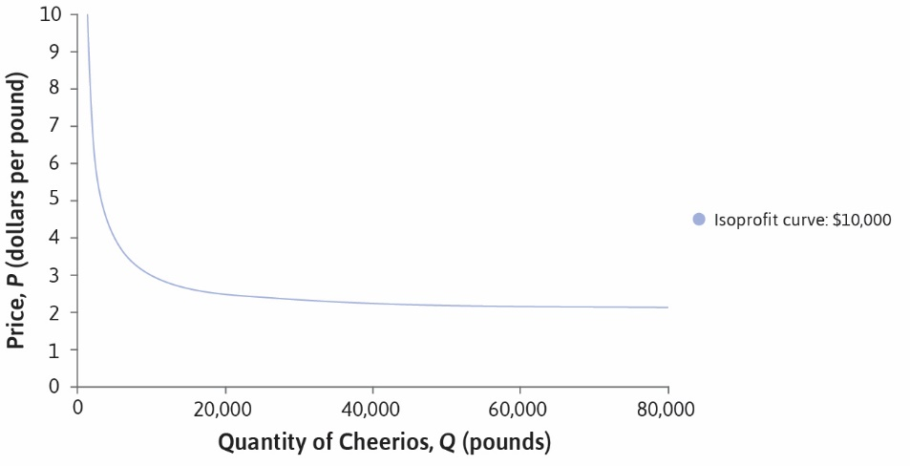

Slide 16
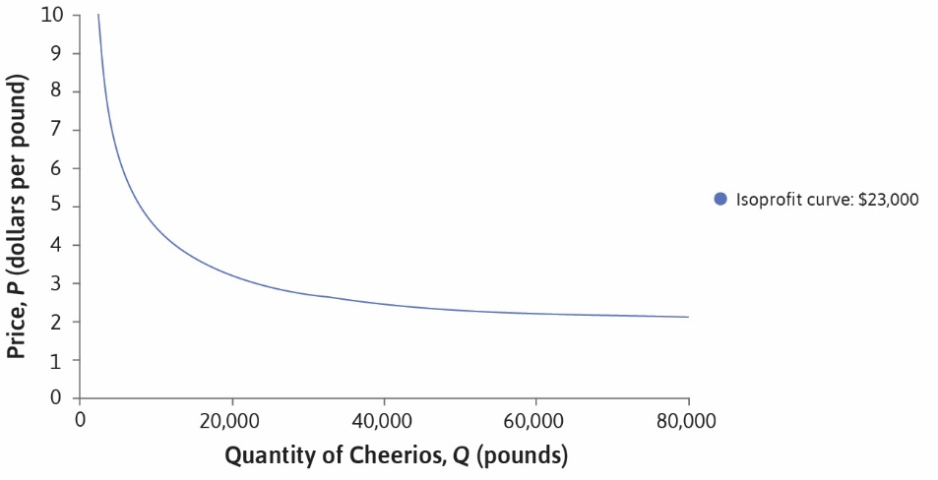

Slide 17
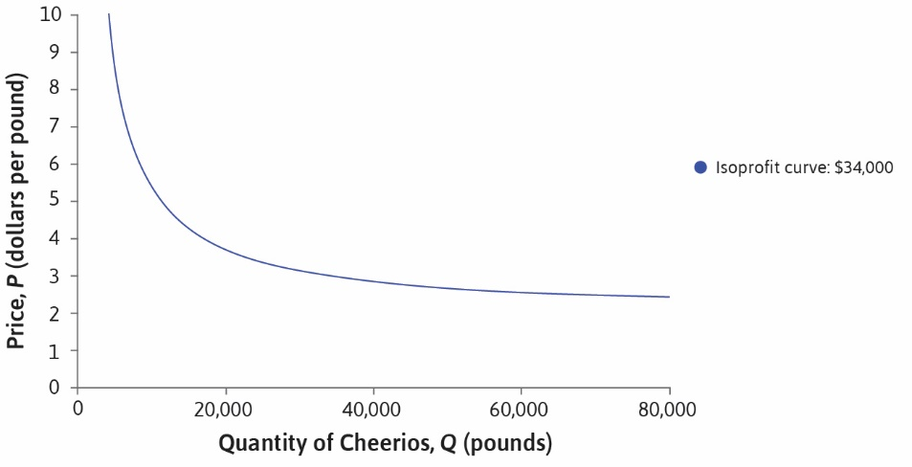

Slide 18
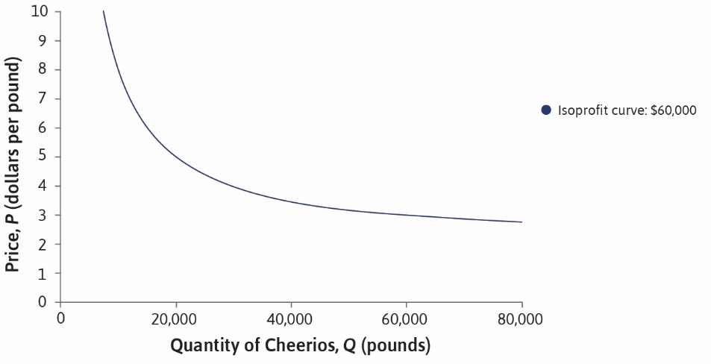

Slide 19
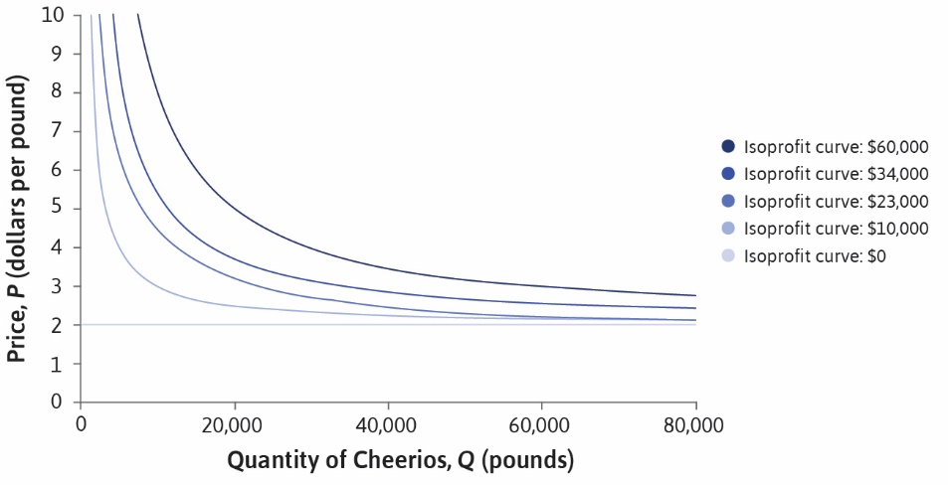

Slide 20
Optimal Choice
Firm would like to be on highest attainable isoprofit curve
But is constrained by the demand curve
The demand curve is a feasible frontier for profits
Highest profit attained at point of tangency E (next slides)

Slide 21
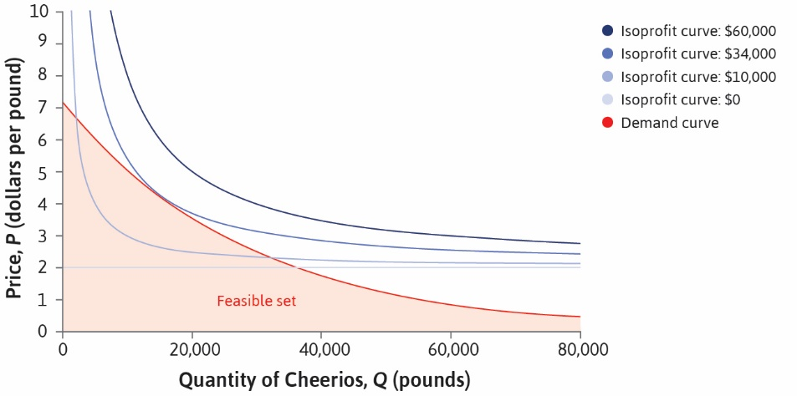

Slide 22


Slide 23
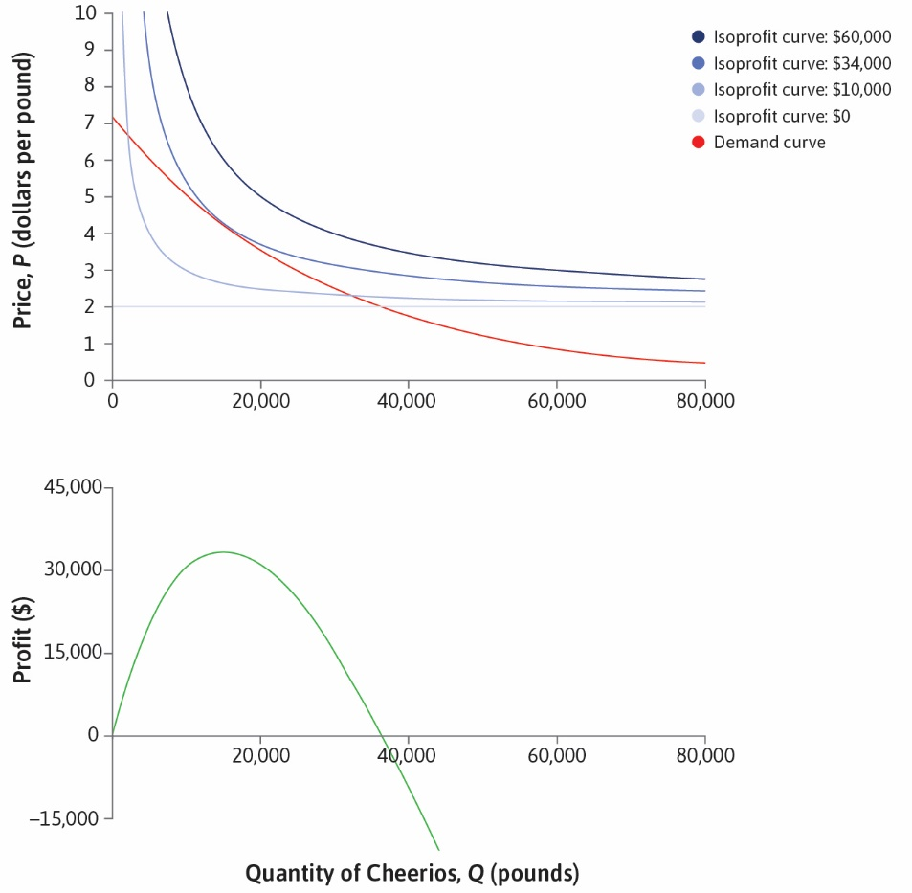

Slide 24


Slide 25


Slide 26


Slide 27
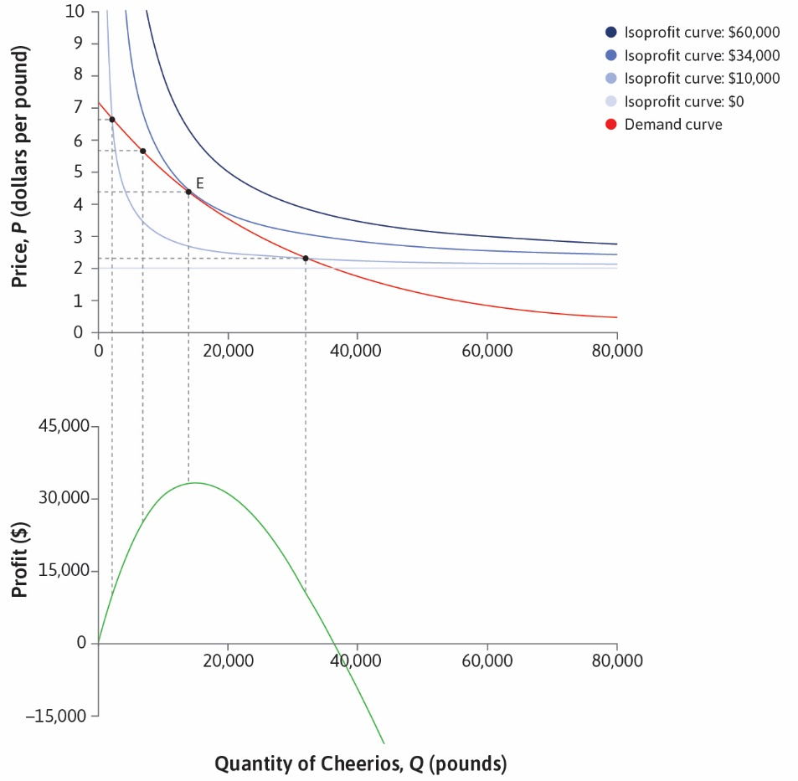

Slide 28
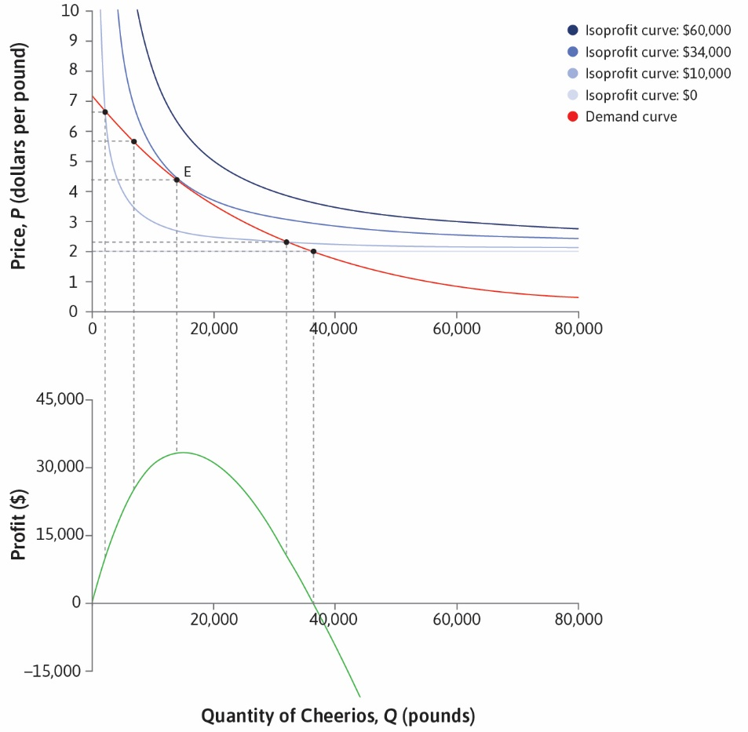

Slide 29


Slide 30
A Comparison
Note similarity to optimal consumer choice
Instead of indifference curves we have isoprofit curves
Instead of feasible frontier we have demand curve
Optimum is at point of tangency as before
Below this, costs are lower but revenues even more so; profits lower
Above this, sales are higher but profits lower
Profits reach zero when price reaches unit cost on the demand curve

